Slide 1
BTP PPT clipboard

Slide 2
Cough Pattern Data Distribution

Slide 4
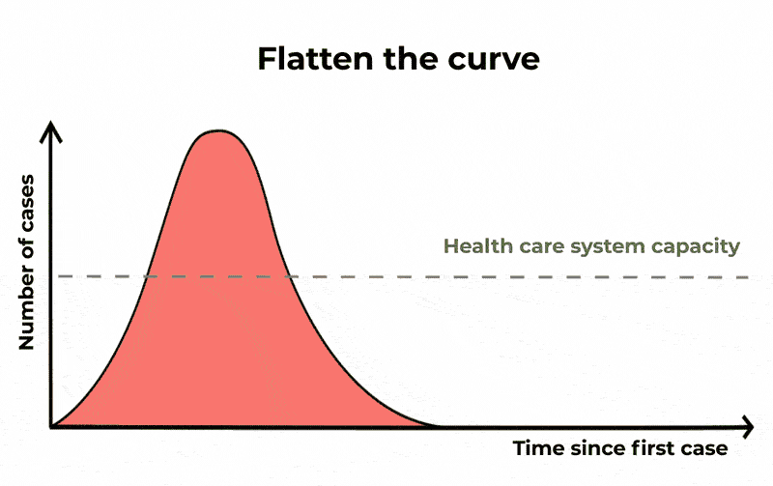
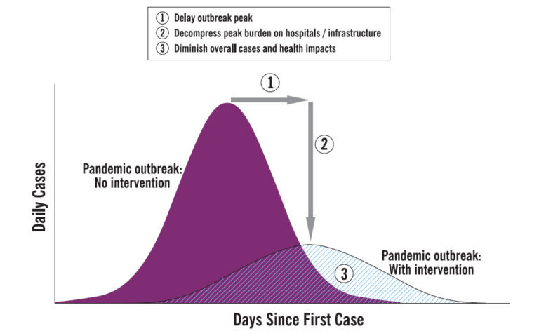

Slide 5
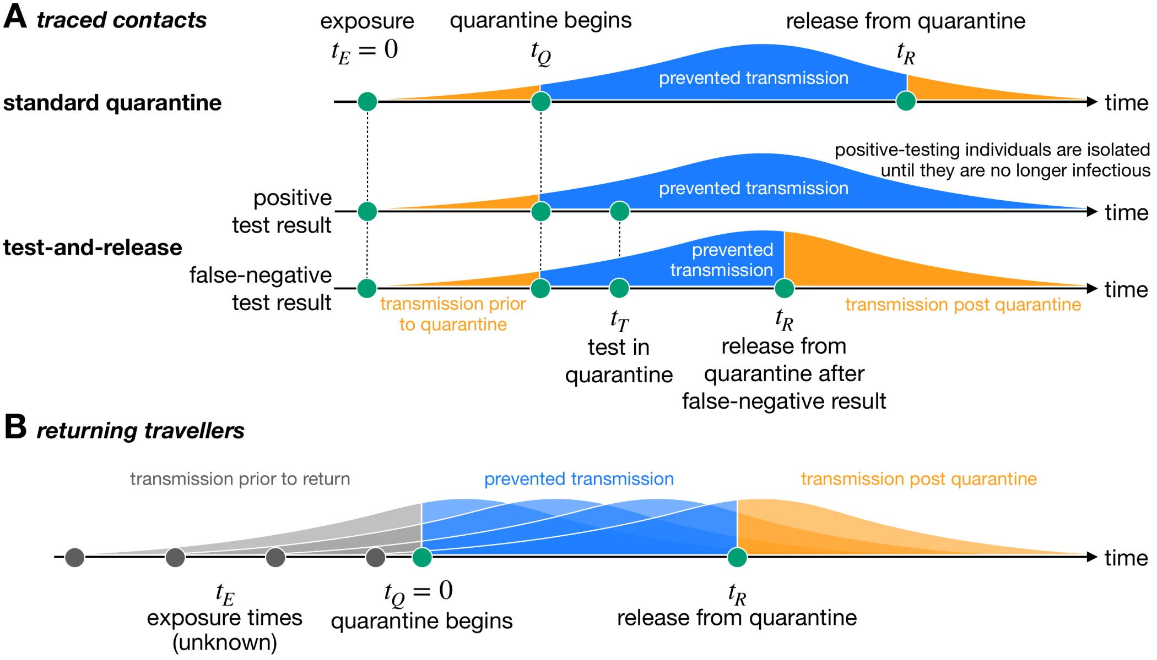
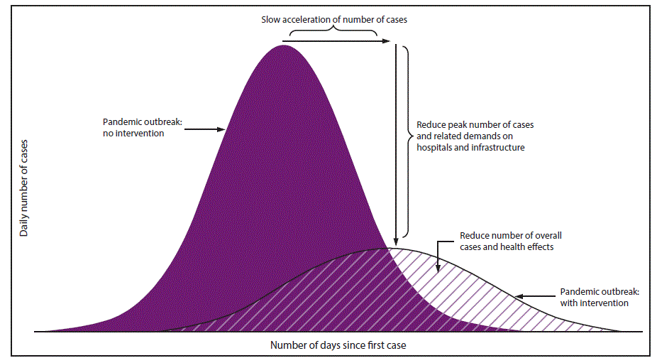
Motivation

Slide 6
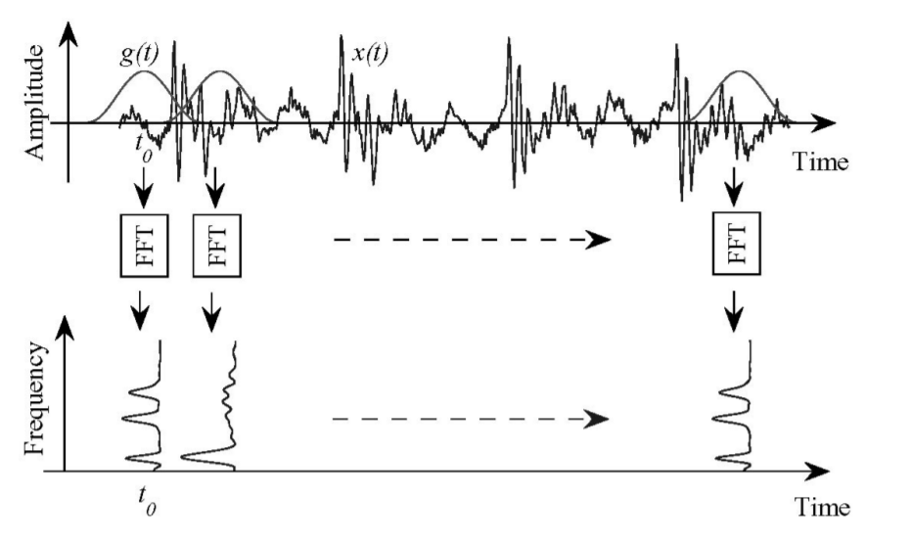

Slide 7
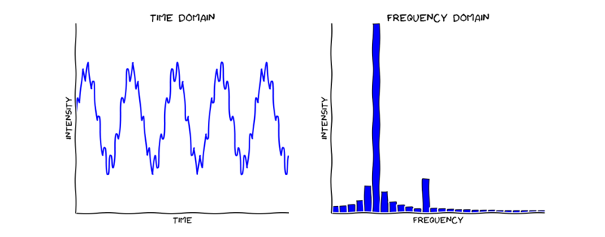
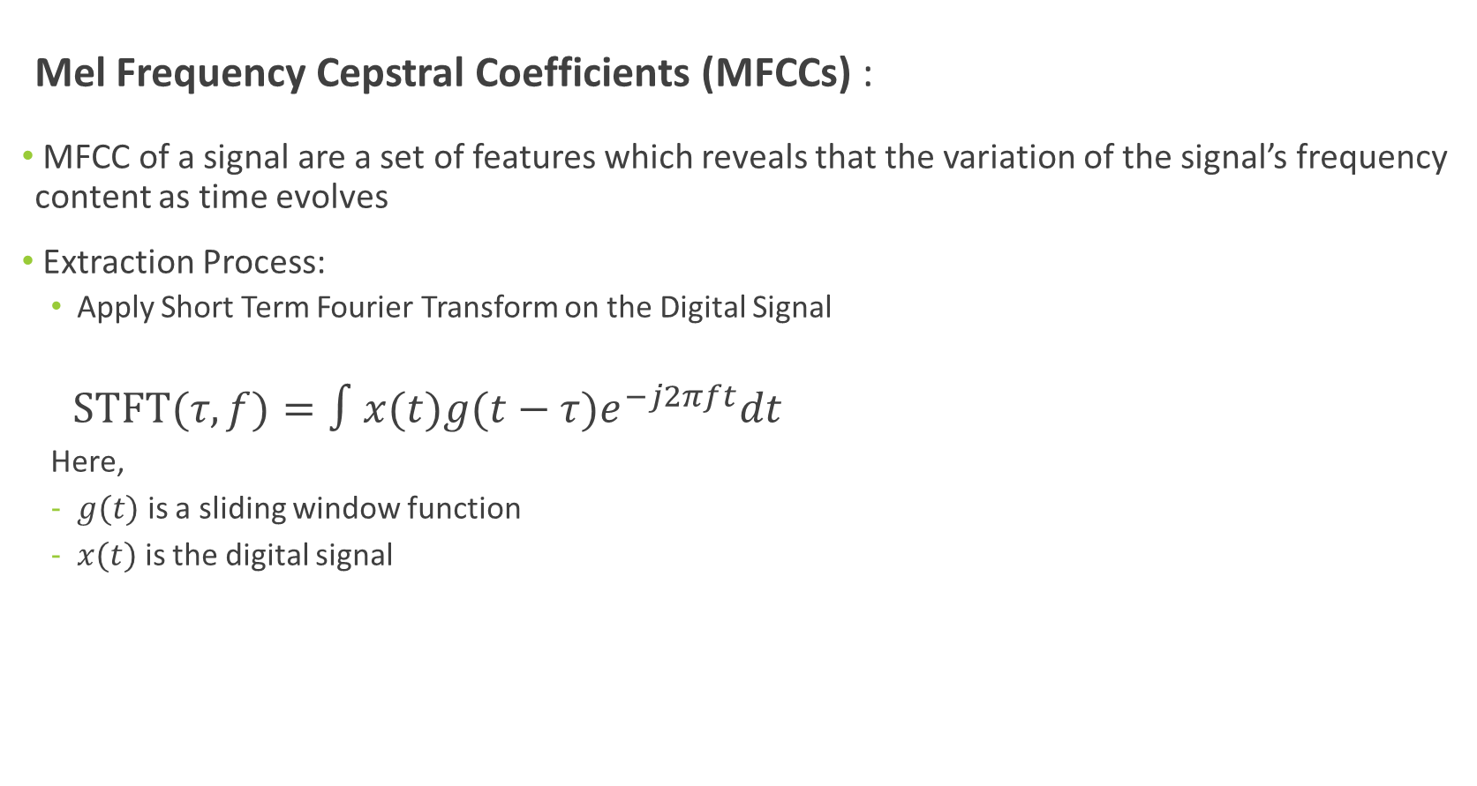
Mel Frequency Cepstral Coefficients (MFCCs) :
MFCC of a signal are a set of features which reveals that the variation of the signal’s frequency content as time evolves
Extraction Process:
Apply Short Term Fourier Transform on the Digital Signal
$STFT⁡(τ,f)=∫x(t)g(t−τ)e^{−j2πft}dt$
Here,
$g(t)$ is a sliding window function
$x(t)$ is the digital signal
Notes:
HOW FEATURES – MFCC
I will now explain how MFCC are extracted from the cough sound
Firstly, STFT is applied on the digital signal of cough sound,
STFT uses a sliding window function $g(t)$ centred at time $τ$ to consecutively perform ‘time localised Fourier transform of the signal $x(t)$. The result reveals that the variation of the signal’s frequency content as time evolves.

Slide 8
Can we make a COVID-19 detection method which:
Can give accurate test results in relatively less time?
Can be performed more frequently (hourly/daily)?
Can detect Newdasdsfsafefjwpidms;k,. Strains?
Can be performed without Medical Assistance?
Can be cheaper than RTPCR?
Notes:
LitRev

Slide 9
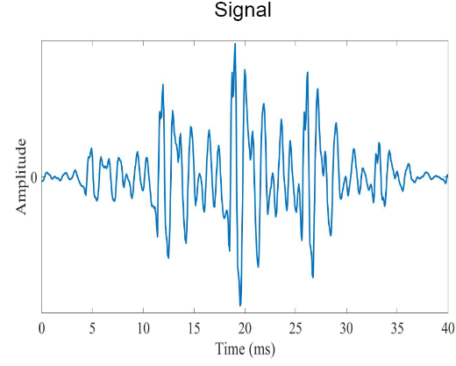
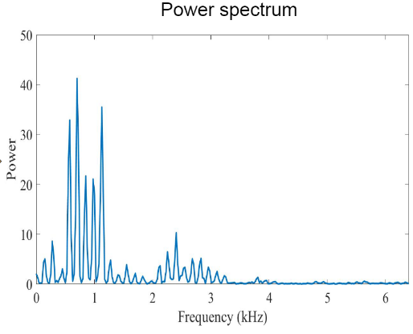
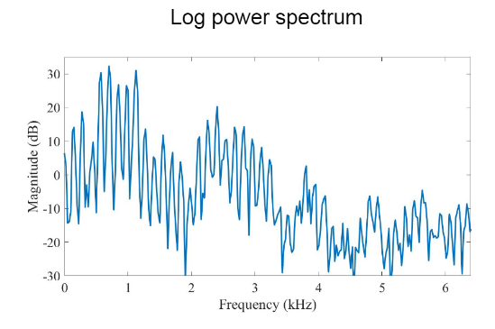
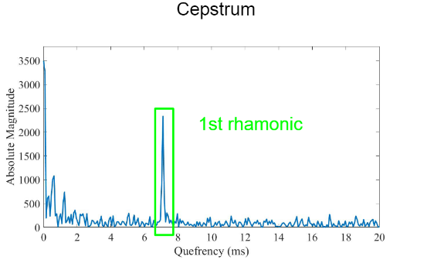
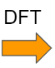
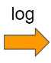

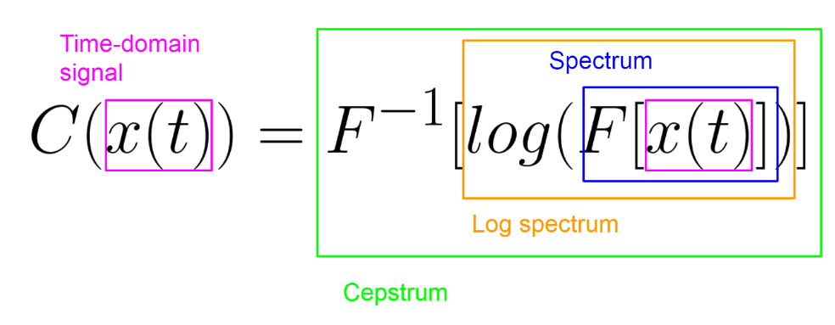
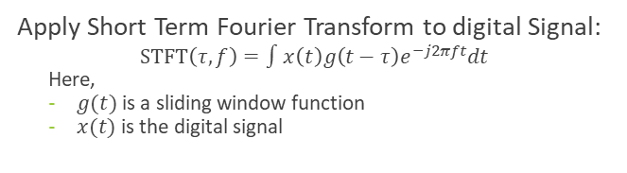
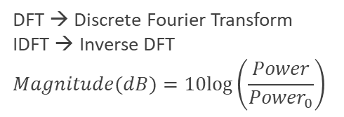
Mel Frequency Cepstral Coefficients (MFCCs) :
MFCC of a signal are a set of features which reveals the variation of the signal’s frequency content as time evolves
Extraction Process:
Apply Short Term Fourier Transform to digital Signal:
$$\operatorname{STFT}\left(τ,f\right)=∫x\left(t\right)g\left(t−τ\right)e^{−j2πft}dt$$
Here,
$g(t)$ is a sliding window function
$x(t)$ is the digital signal
DFT → Discrete Fourier Transform
IDFT → Inverse DFT
$$Magnitude(dB)=10log⁡\left(\frac{Power}{{Power}_{0}}\right)$$
Notes:
HOW FEATURES – MFCC
I will now explain how MFCC are extracted from the cough sound
Firstly, STFT is applied on the digital signal of cough sound,
STFT uses a sliding window function $g(t)$ centred at time $τ$ to consecutively perform ‘time localised Fourier transform of the signal $x(t)$. The result reveals that the variation of the signal’s frequency content as time evolves.

Slide 10
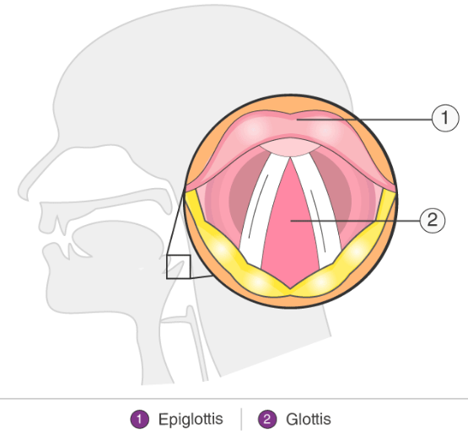
Vocal Tract
Glottis
Notes:
First 20 coordinates on X-axis are the required MFCCs

Slide 11
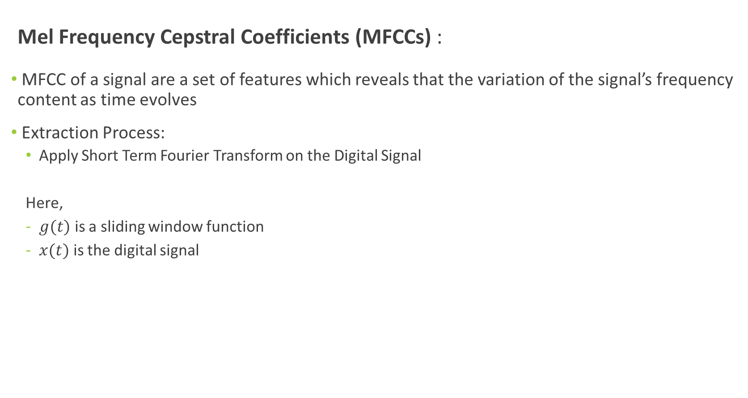
Mel Frequency Cepstral Coefficients (MFCCs) :
MFCC of a signal are a set of features which reveals that the variation of the signal’s frequency content as time evolves
Extraction Process:
Apply Short Term Fourier Transform on the Digital Signal
Here,
$g(t)$ is a sliding window function
$x(t)$ is the digital signal
Notes:
HOW FEATURES – MFCC
I will now explain how MFCC are extracted from the cough sound
Firstly, STFT is applied on the digital signal of cough sound,
STFT uses a sliding window function $g(t)$ centred at time $τ$ to consecutively perform ‘time localised Fourier transform of the signal $x(t)$. The result reveals that the variation of the signal’s frequency content as time evolves.

Slide 13
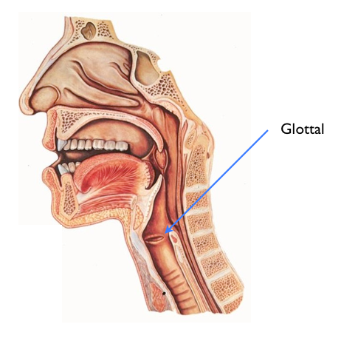
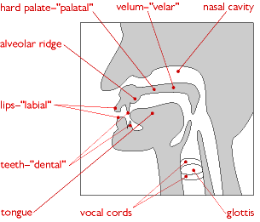
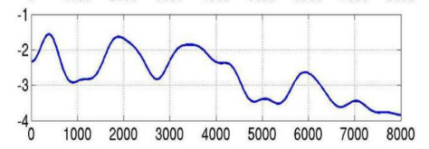
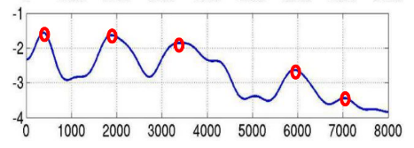
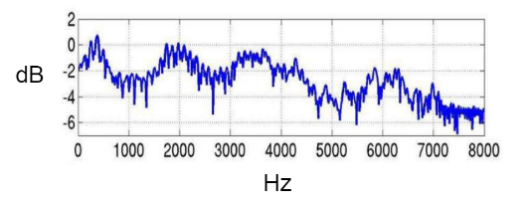
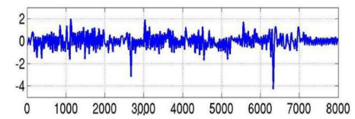
Log Spectrum due to Vocal Tract
Log Spectrum of portion of signal
Log Spectrum due to Glottal Pulse

Slide 14
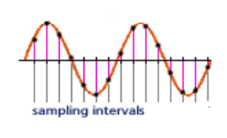
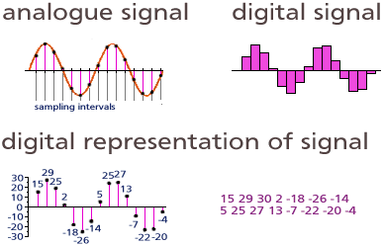
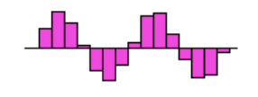
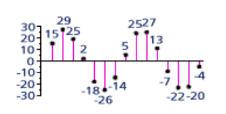
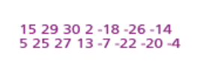
Analog to Digital Converter (ADC):

Slide 15
$$k$$

Slide 16
MFCC (Mel Frequency Cepstral Coefficients):
Notes:
Now that we have the cough audio signals in digital format we need to identify which features to extract in order to obtain maximum information in the cough.

Slide 17
Can we make a COVID-19 detection method which:
Can give accurate test results in relatively less time?
Can be performed more frequently (hourly/daily)?
Can detect Newdasdsfsafefjwpidms;k,. Strains?
Can be performed without Medical Assistance?
Can be cheaper than RTPCR?
Notes:
LitRev

Slide 18
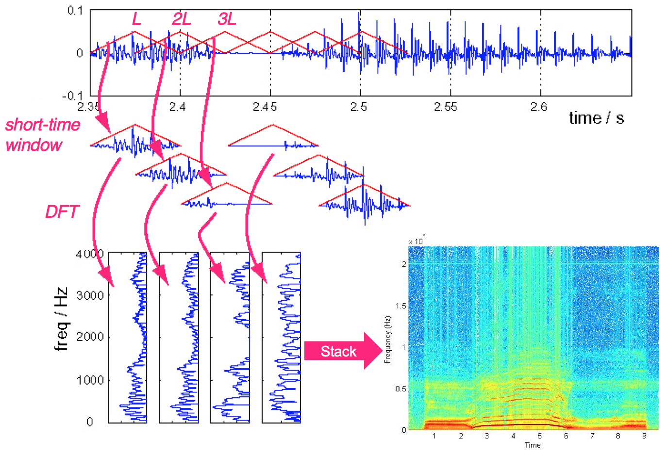

Slide 19
Can we make a COVID-19 detection method which:
Can give accurate test results in relatively less time?
Can be performed more frequently (hourly/daily)?
Can detect New Strains?
Can be performed without Medical Assistance?
Can be cheaper than RTPCR?

Slide 21
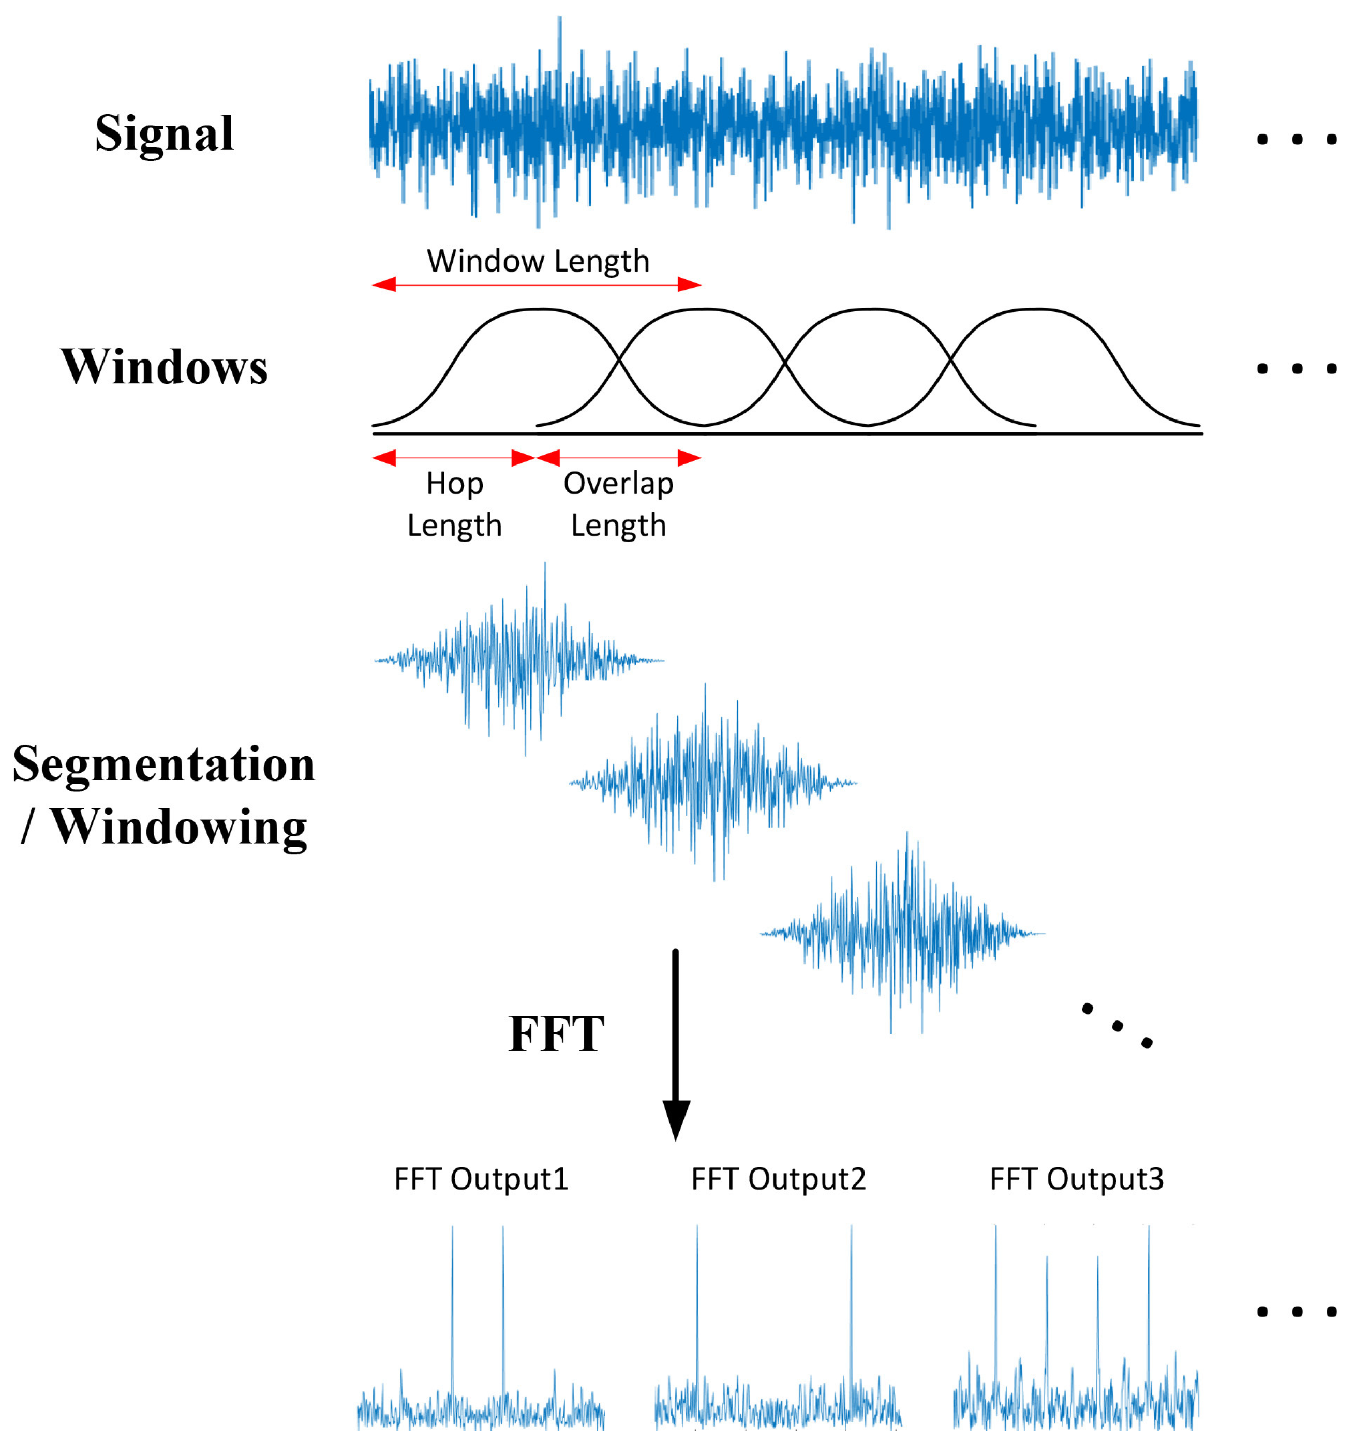
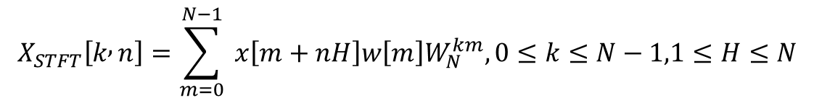
Mel Frequency Cepstral Coefficients (MFCCs) :
MFCC of a signal are a set of features which concisely describe the overall shape of a spectrum.
Extraction Process:
Apply Short Term Fourier Transform on the Digital Signal
$$X_{STFT}\left[k , n\right]=\sum_{m=0}^{N−1}{ }x\left[m+nH\right]w\left[m\right]W_{N}^{km},0≤k≤N−1,1≤H≤N$$
Notes:
HOW FEATURES - MFCC

Slide 24
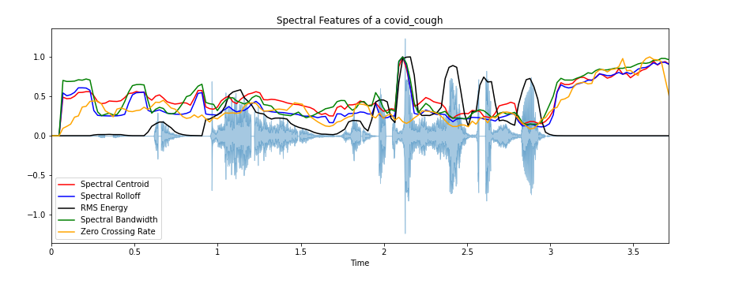
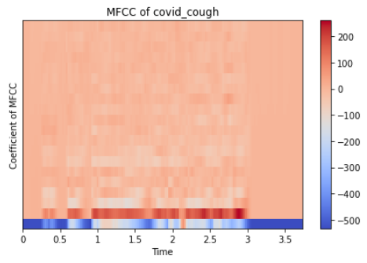
Methodology
A total of 25 time-frequency features are extracted from each cough audio sample
These features were extracted after a careful literature review on cough identification, detection and classification
Notes:
WHY FEATURES --Now that we have the cough audio signals in digital format we need to identify which features to extract in order to obtain maximum spectral information in the cough. The

Slide 25
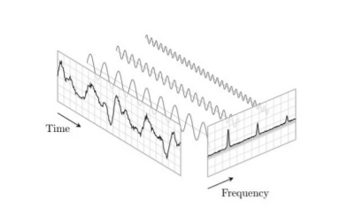
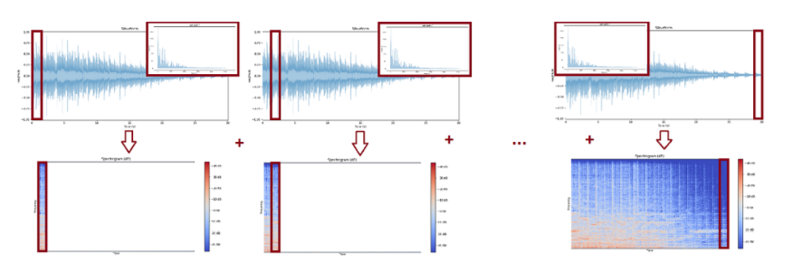

Slide 26
Feature Extraction :
A total of 25 time-frequency features are extracted from each cough audio sample
5 features were mean of instantaneous frequency peaks of each audio wave and 20 MFCCs(Mel Frequency Cepstral Coefficients)
These features were extracted after a careful literature review on cough identification, detection and classification
Amplitude
Notes:
WHY FEATURES --Now that we have the cough audio signals in digital format we need to identify which features to extract in order to obtain maximum spectral information in the cough. The

